Slide 1

CPU Scheduling

Slide 2
CPU Scheduling
Basic Concepts
Scheduling Criteria
Scheduling Algorithms
Thread Scheduling
Multiple-Processor Scheduling
Real-Time CPU Scheduling
Operating Systems Examples
Algorithm Evaluation

Slide 3
Objectives
To introduce CPU scheduling, which is the basis for multiprogrammed operating systems
To describe various CPU-scheduling algorithms
To discuss evaluation criteria for selecting a CPU-scheduling algorithm for a particular system
To examine the scheduling algorithms of several operating systems

Slide 4
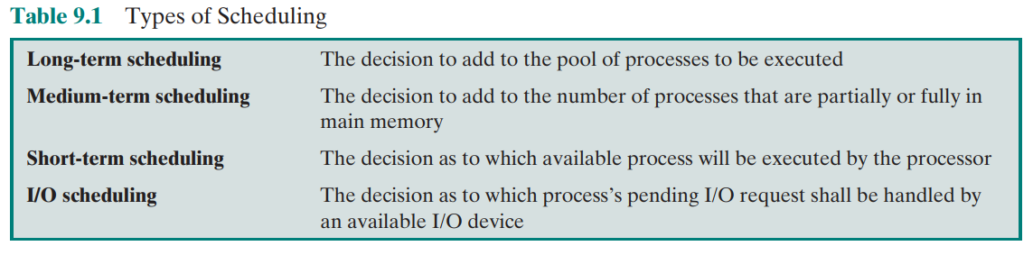
CPU Scheduling

Slide 5
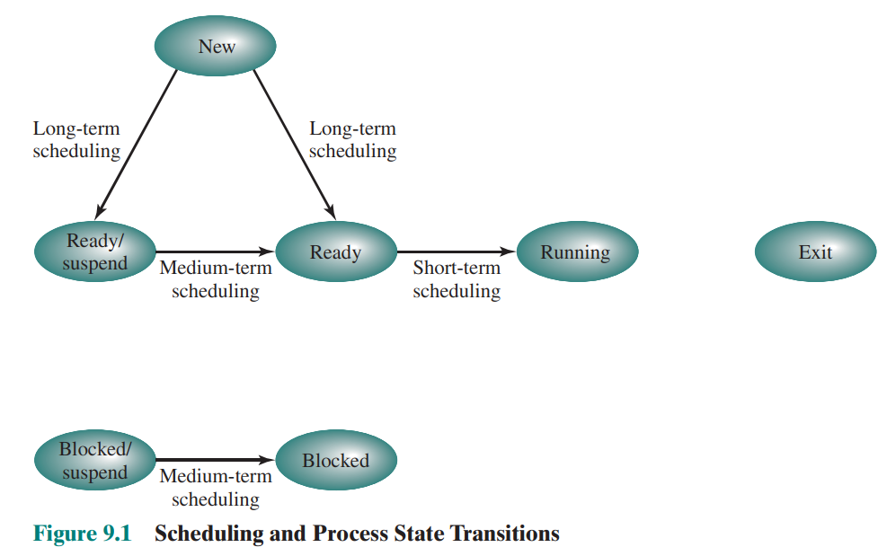
CPU Scheduling Types

Slide 6
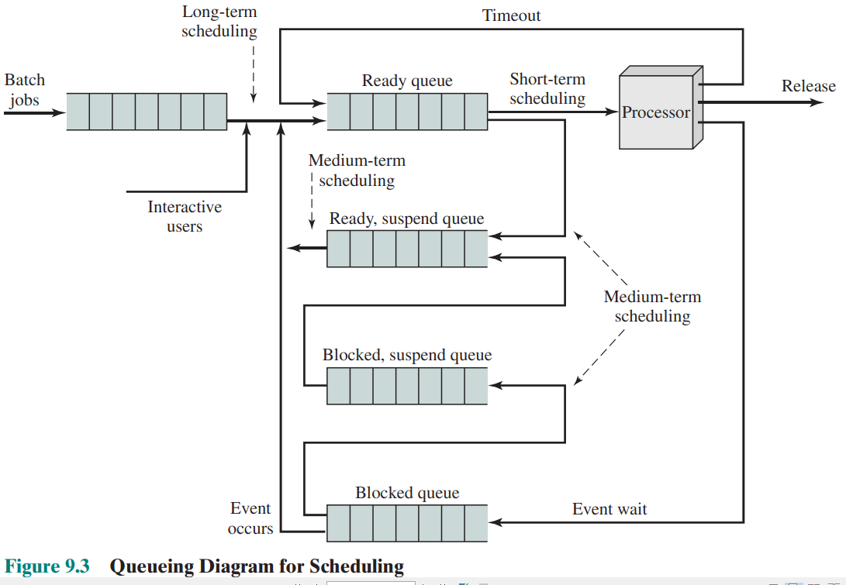
CPU Scheduling Queues

Slide 7
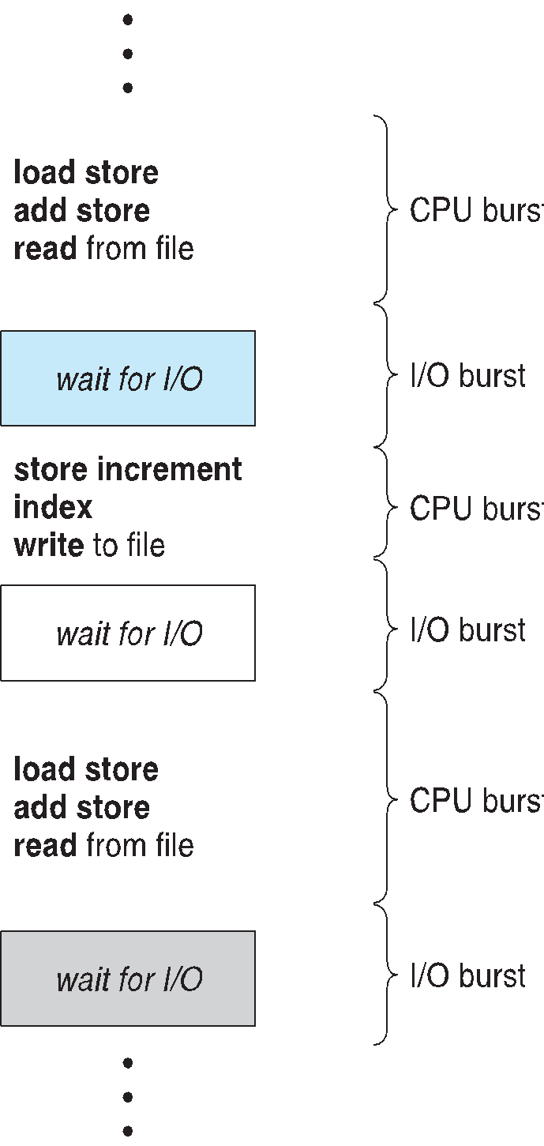
Basic Concepts
Maximum CPU utilization obtained with multiprogramming
CPU–I/O Burst Cycle – Process execution consists of a cycle of CPU execution and I/O wait
CPU burst followed by I/O burst
CPU burst distribution is of main concern

Slide 8
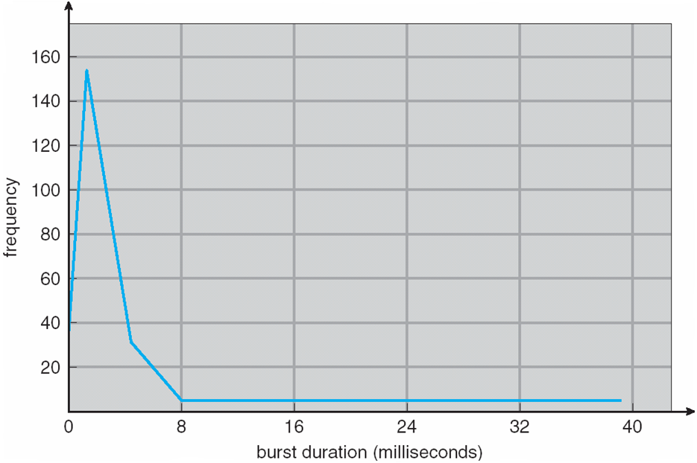
Histogram of CPU-burst Times

Slide 9
CPU Scheduler
Short-term scheduler selects from among the processes in ready queue, and allocates the CPU to one of them
Queue may be ordered in various ways
CPU scheduling decisions may take place when a process:
1. Switches from running to waiting state
2. Switches from running to ready state
3. Switches from waiting to ready
Terminates
Scheduling under 1 and 4 is nonpreemptive
All other scheduling is preemptive
Consider access to shared data
Consider preemption while in kernel mode
Consider interrupts occurring during crucial OS activities

Slide 10
Dispatcher
Dispatcher module gives control of the CPU to the process selected by the short-term scheduler; this involves:
switching context
switching to user mode
jumping to the proper location in the user program to restart that program
Dispatch latency – time it takes for the dispatcher to stop one process and start another running

Slide 11
Scheduling Criteria
CPU utilization – keep the CPU as busy as possible
Throughput – # of processes that complete their execution per time unit
Turnaround time – amount of time to execute a particular process
Waiting time – amount of time a process has been waiting in the ready queue
Response time – amount of time it takes from when a request was submitted until the first response is produced, not output (for time-sharing environment)

Slide 12
Scheduling Algorithm Optimization Criteria
Max CPU utilization
Max throughput
Min turnaround time
Min waiting time
Min response time

Slide 13
Scheduling Algorithm Optimization Criteria
FCFS – First Come First Serve
Priority Scheduling
SJF – Shortest Job First
SPN – Shortest Process Next
SRTF – Shortest Remaining Time First
Round Robin Algorithm
Feedback Scheduling
Multi-level Queue Scheduling
UNIX Scheduling Algorithm
Windows Scheduling Algorithm
Solaris Scheduling Algorithm

Slide 14
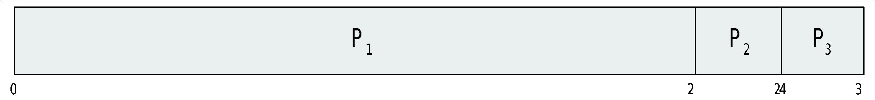
First- Come, First-Served (FCFS) Scheduling
Process Burst Time
P₁ 24
P₂ 3
P₃ 3
Suppose that the processes arrive in the order: P₁ , P₂ , P₃ The Gantt Chart for the schedule is:
Waiting time for P₁ = 0; P₂ = 24; P₃ = 27
Average waiting time: (0 + 24 + 27)/3 = 17

Slide 15
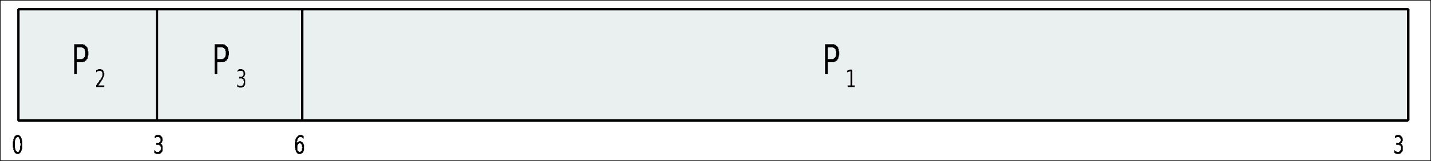
FCFS Scheduling (Cont.)
Suppose that the processes arrive in the order:
P₂ , P₃ , P₁
The Gantt chart for the schedule is:
Waiting time for P₁ = 6; P₂ = 0; P₃ = 3
Average waiting time: (6 + 0 + 3)/3 = 3
Much better than previous case
Convoy effect - short process behind long process
Consider one CPU-bound and many I/O-bound processes
Favors CPU bound processes

Slide 16
Priority Scheduling
A priority number (integer) is associated with each process
The CPU is allocated to the process with the highest priority (smallest integer ≡ highest priority)
Preemptive
Nonpreemptive
SJF is priority scheduling where priority is the inverse of predicted next CPU burst time
Problem ≡ Starvation – low priority processes may never execute
Solution ≡ Aging – as time progresses increase the priority of the process

Slide 17
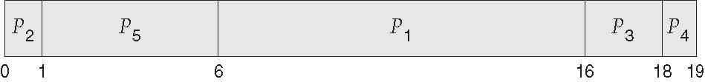
Example of Priority Scheduling
ProcessA arri Burst TimeT Priority
P₁ 10 3
P₂ 1 1
P₃ 2 4
P₄ 1 5
P₅ 5 2
Priority scheduling Gantt Chart
Average waiting time = 8.2 msec

Slide 18
Shortest-Job-First (SJF) Scheduling
Associate with each process the length of its next CPU burst
Use these lengths to schedule the process with the shortest time
SJF is optimal – gives minimum average waiting time for a given set of processes
The difficulty is knowing the length of the next CPU request
Could ask the user

Slide 19
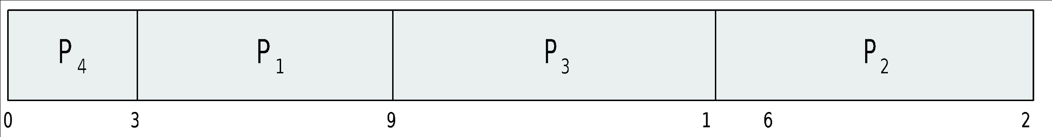
Example of SJF
ProcessArriv Burst Time
P₁ 0.0 6
P₂ 2.0 8
P₃ 4.0 7
P₄ 5.0 3
SJF scheduling chart
Average waiting time = (3 + 16 + 9 + 0) / 4 = 7

Slide 20
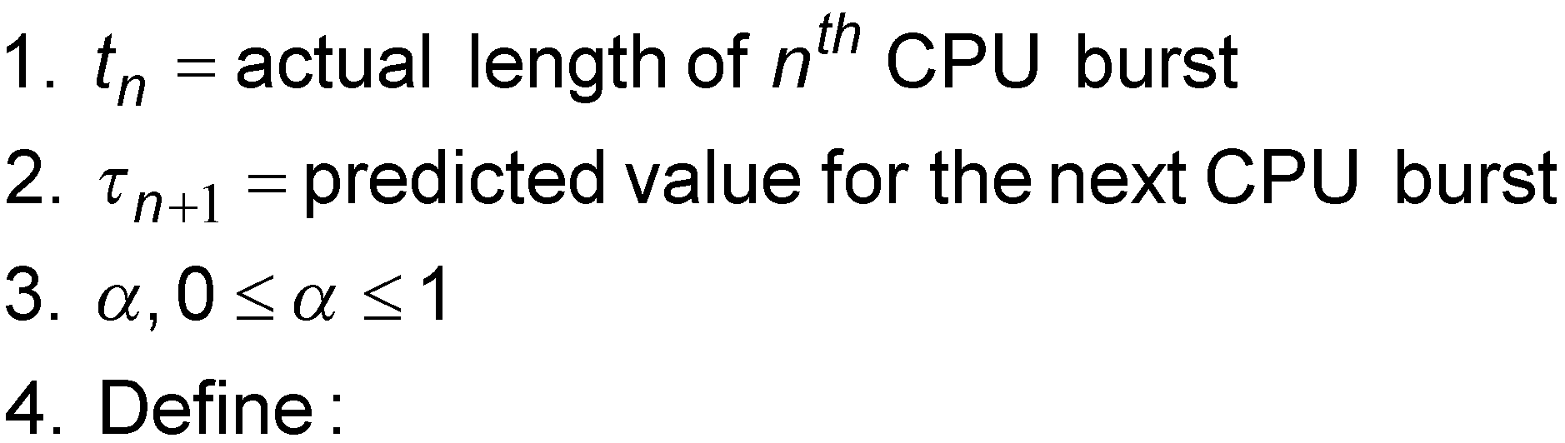
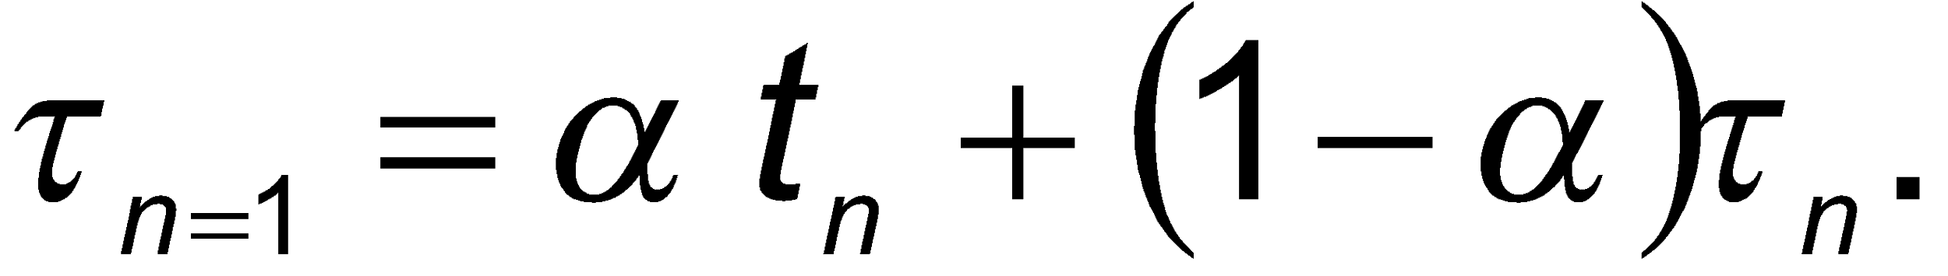
Determining Length of Next CPU Burst
Can only estimate the length – should be similar to the previous one
Then pick process with shortest predicted next CPU burst
Can be done by using the length of previous CPU bursts, using exponential averaging
Commonly, α set to ½
Preemptive version called shortest-remaining-time-first

Slide 21
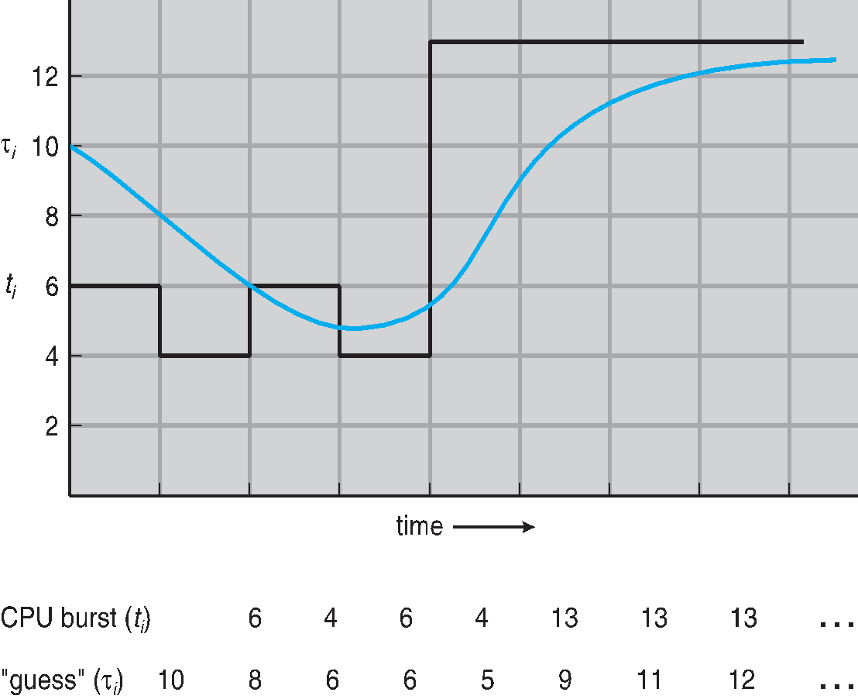
Prediction of the Length of the Next CPU Burst

Slide 22
Examples of Exponential Averaging
α =0
τ_{n+1} = τ_{n}
Recent history does not count
α =1
τ_{n+1} = α t_{n}
Only the actual last CPU burst counts
If we expand the formula, we get:
τ_{n+1} = α t_{n}+(1 - α)α t_{n} ₋₁ + …
+(1 - α )^{j} α t_{n} _{-j} + …
+(1 - α )^{n +1} τ₀
Since both α and (1 - α) are less than or equal to 1, each successive term has less weight than its predecessor

Slide 23
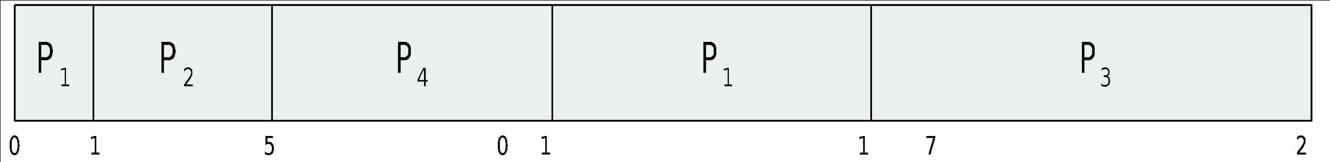
Example of Shortest-remaining-time-first
Now we add the concepts of varying arrival times and preemption to the analysis
ProcessA arri Arrival TimeT Burst Time
P₁ 0 8
P₂ 1 4
P₃ 2 9
P₄ 3 5
Preemptive SJF Gantt Chart
Average waiting time = [(10-1)+(1-1)+(17-2)+5-3)]/4 = 26/4 = 6.5 msec

Slide 24
Round Robin (RR)
Each process gets a small unit of CPU time (time quantum q), usually 10-100 milliseconds. After this time has elapsed, the process is preempted and added to the end of the ready queue.
If there are n processes in the ready queue and the time quantum is q, then each process gets 1/n of the CPU time in chunks of at most q time units at once. No process waits more than (n-1)q time units.
Timer interrupts every quantum to schedule next process
Performance
q large ⇒ FIFO
q small ⇒ q must be large with respect to context switch, otherwise overhead is too high

Slide 25
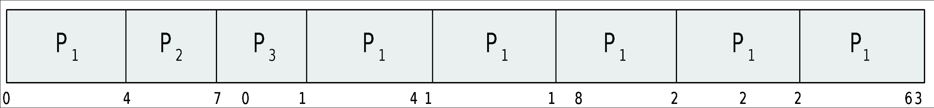
Example of RR with Time Quantum = 4
Process Burst Time
P₁ 24
P₂ 3
P₃ 3
The Gantt chart is:
Typically, higher average turnaround than SJF, but better response
q should be large compared to context switch time
q usually 10ms to 100ms, context switch < 10 usec

Slide 26
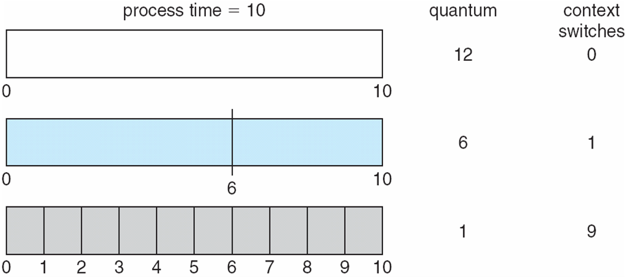
Time Quantum and Context Switch Time

Slide 27
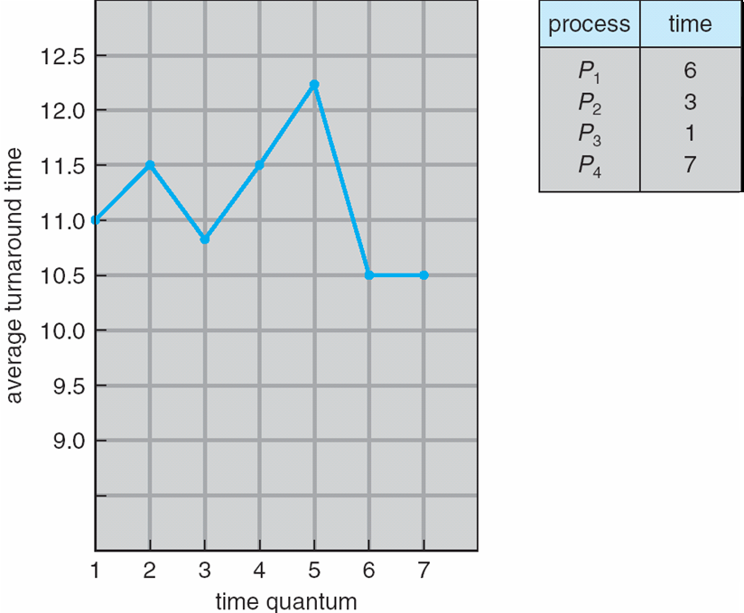
Turnaround Time Varies With The Time Quantum
80% of CPU bursts should be shorter than q

Slide 28
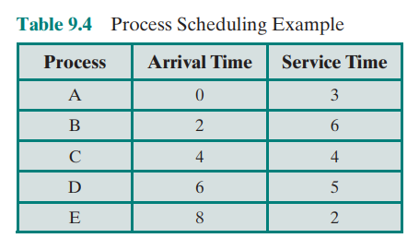
CPU Scheduling Characteristics

Slide 29
Multilevel Feedback Queue
A process can move between the various queues; aging can be implemented this way
Multilevel-feedback-queue scheduler defined by the following parameters:
number of queues
scheduling algorithms for each queue
method used to determine when to upgrade a process
method used to determine when to demote a process
method used to determine which queue a process will enter when that process needs service

Slide 30
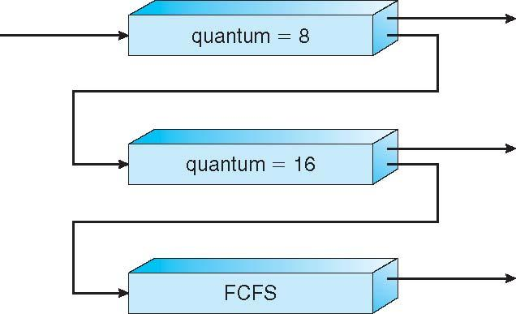
Example of Multilevel Feedback Queue
Three queues:
Q₀ – RR with time quantum 8 milliseconds
Q₁ – RR time quantum 16 milliseconds
Q₂ – FCFS
Scheduling
A new job enters queue Q₀ which is served FCFS
When it gains CPU, job receives 8 milliseconds
If it does not finish in 8 milliseconds, job is moved to queue Q₁
At Q₁ job is again served FCFS and receives 16 additional milliseconds
If it still does not complete, it is preempted and moved to queue Q₂

Slide 31
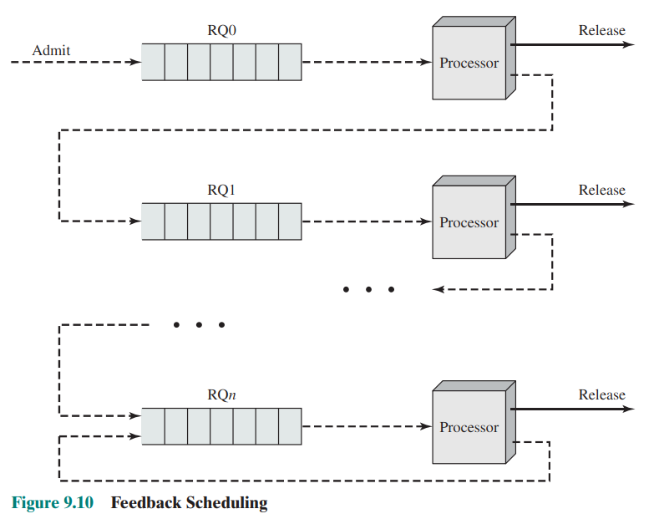
CPU Scheduling - Feedback

Slide 32
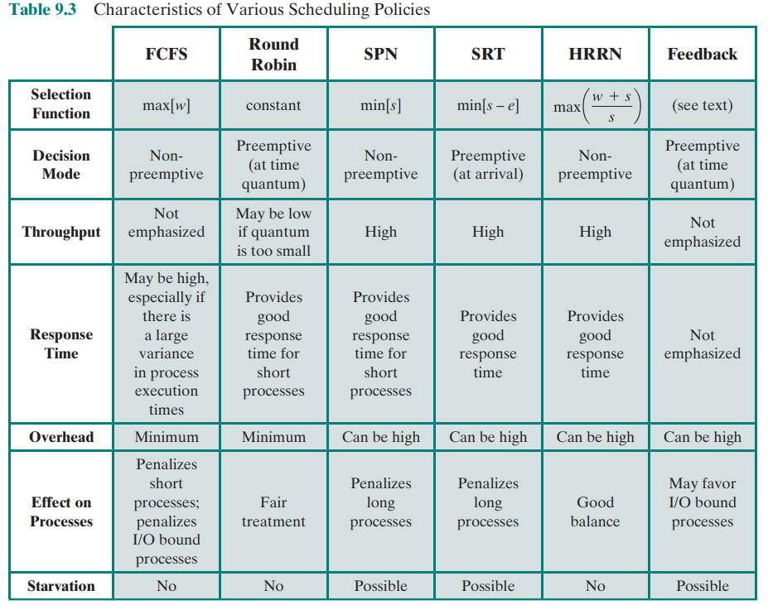
CPU Scheduling Charactristics

Slide 33
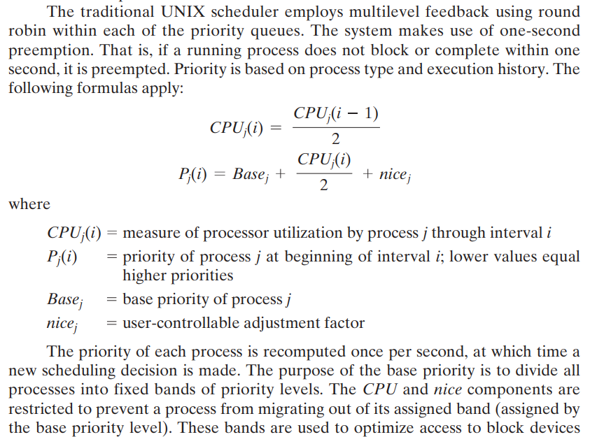
CPU Scheduling - UNIX

Slide 34
Multilevel Queue
Ready queue is partitioned into separate queues, eg:
foreground (interactive)
background (batch)
Process permanently in a given queue
Each queue has its own scheduling algorithm:
foreground – RR
background – FCFS
Scheduling must be done between the queues:
Fixed priority scheduling; (i.e., serve all from foreground then from background). Possibility of starvation.
Time slice – each queue gets a certain amount of CPU time which it can schedule amongst its processes; i.e., 80% to foreground in RR
20% to background in FCFS

Slide 35
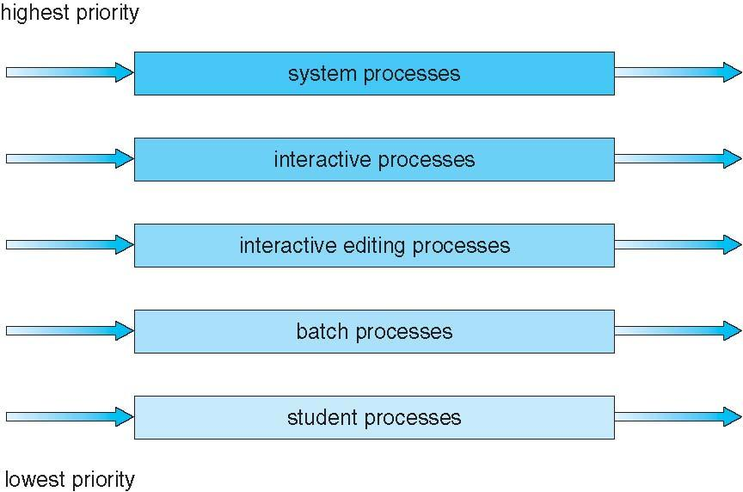
Multilevel Queue Scheduling

Slide 36
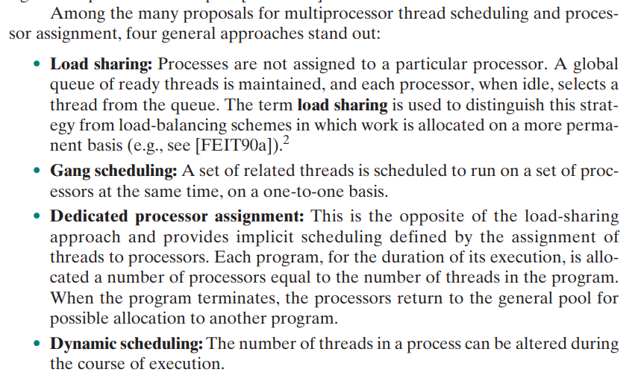
CPU Scheduling – Multi-processors

Slide 37
Multiple-Processor Scheduling
CPU scheduling more complex when multiple CPUs are available
Homogeneous processors within a multiprocessor
Asymmetric multiprocessing – only one processor accesses the system data structures, alleviating the need for data sharing
Symmetric multiprocessing (SMP) – each processor is self-scheduling, all processes in common ready queue, or each has its own private queue of ready processes
Currently, most common
Processor affinity – process has affinity for processor on which it is currently running
soft affinity
hard affinity
Variations including processor sets

Slide 38
Multiple-Processor Scheduling – Load Balancing
If SMP, need to keep all CPUs loaded for efficiency
Load balancing attempts to keep workload evenly distributed
Push migration – periodic task checks load on each processor, and if found pushes task from overloaded CPU to other CPUs
Pull migration – idle processors pulls waiting task from busy processor

Slide 39
Multicore Processors
Recent trend to place multiple processor cores on same physical chip
Faster and consumes less power
Multiple threads per core also growing
Takes advantage of memory stall to make progress on another thread while memory retrieve happens

Slide 40
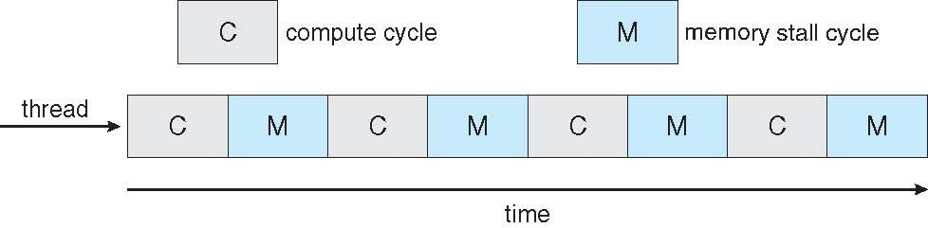

Multithreaded Multicore System

Slide 41
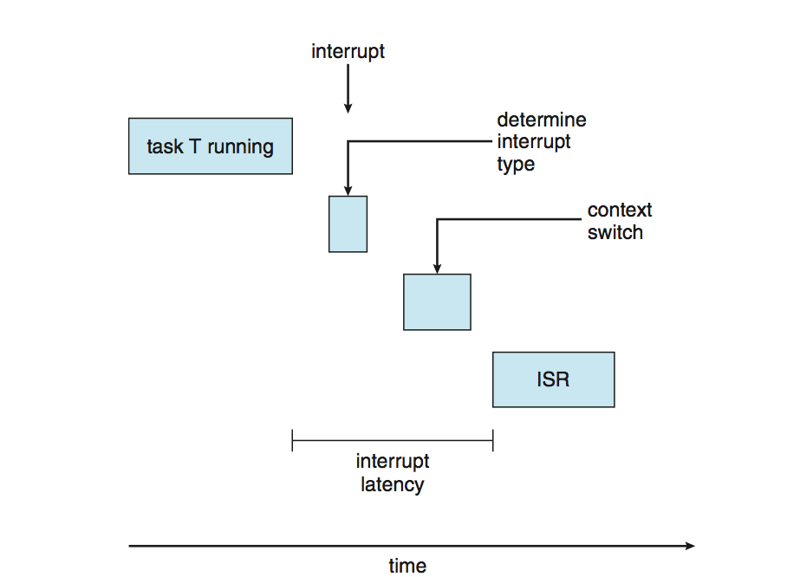
Real-Time CPU Scheduling
Can present obvious challenges
Soft real-time systems – no guarantee as to when critical real-time process will be scheduled
Hard real-time systems – task must be serviced by its deadline
Two types of latencies affect performance
Interrupt latency – time from arrival of interrupt to start of routine that services interrupt
Dispatch latency – time for schedule to take current process off CPU and switch to another

Slide 42
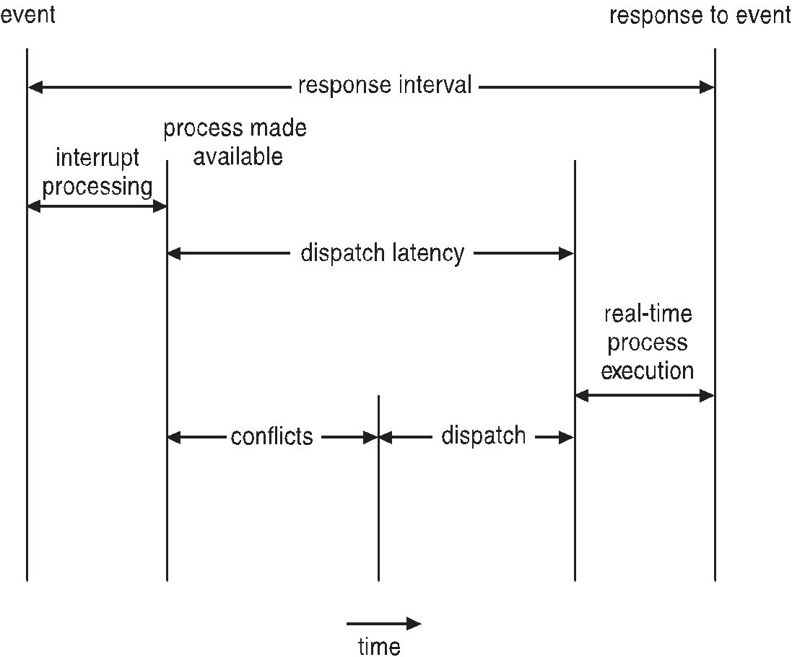
Real-Time CPU Scheduling (Cont.)
Conflict phase of dispatch latency:
Preemption of any process running in kernel mode
Release by low-priority process of resources needed by high-priority processes

Slide 43
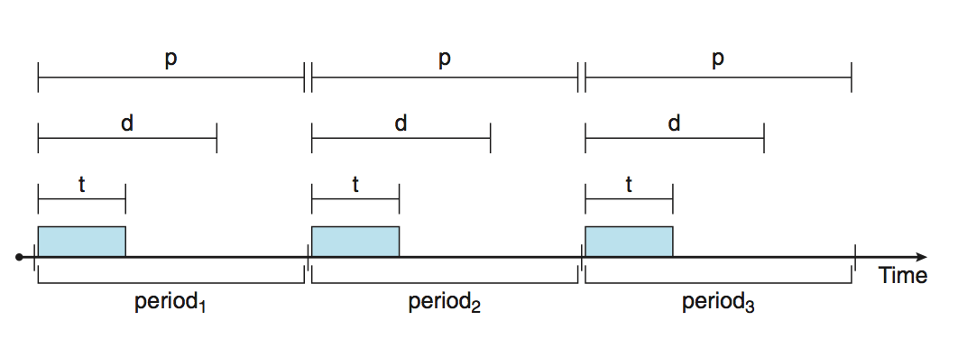
Priority-based Scheduling
For real-time scheduling, scheduler must support preemptive, priority-based scheduling
But only guarantees soft real-time
For hard real-time must also provide ability to meet deadlines
Processes have new characteristics: periodic ones require CPU at constant intervals
Has processing time t, deadline d, period p
0 ≤ t ≤ d ≤ p
Rate of periodic task is 1/p

Slide 44
Virtualization and Scheduling
Virtualization software schedules multiple guests onto CPU(s)
Each guest doing its own scheduling
Not knowing it doesn’t own the CPUs
Can result in poor response time
Can effect time-of-day clocks in guests
Can undo good scheduling algorithm efforts of guests

Slide 45
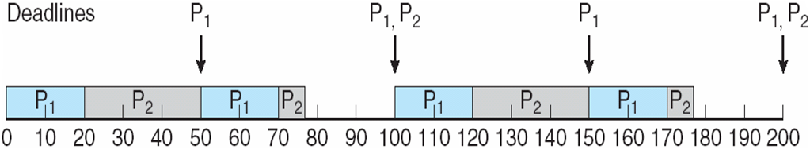
Rate Montonic Scheduling
A priority is assigned based on the inverse of its period
Shorter periods = higher priority;
Longer periods = lower priority
P₁ is assigned a higher priority than P₂.

Slide 46
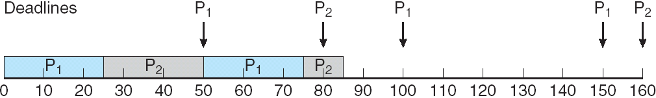
Missed Deadlines with Rate Monotonic Scheduling

Slide 47
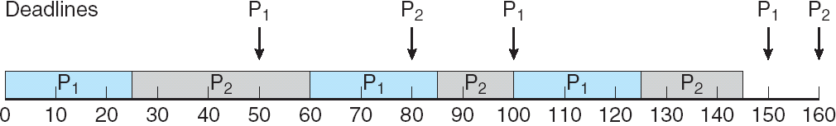
Earliest Deadline First Scheduling (EDF)
Priorities are assigned according to deadlines: the earlier the deadline, the higher the priority;
the later the deadline, the lower the priority

Slide 48
Proportional Share Scheduling
T shares are allocated among all processes in the system
An application receives N shares where N < T
This ensures each application will receive N / T of the total processor time

Slide 49
POSIX Real-Time Scheduling
The POSIX.1b standard
API provides functions for managing real-time threads
Defines two scheduling classes for real-time threads:
SCHED_FIFO - threads are scheduled using a FCFS strategy with a FIFO queue. There is no time-slicing for threads of equal priority
SCHED_RR - similar to SCHED_FIFO except time-slicing occurs for threads of equal priority
Defines two functions for getting and setting scheduling policy:
pthread_attr_getsched_policy(pthread_attr_t *attr, int *policy)
pthread_attr_setsched_policy(pthread_attr_t *attr, int policy)

Slide 50
POSIX Real-Time Scheduling API
#include <pthread.h>
#include <stdio.h>
#define NUM_THREADS 5
int main(int argc, char *argv[])
{
int i, policy; pthread_t_tid[NUM_THREADS];
pthread_attr_t attr;
/* get the default attributes */
pthread_attr_init(&attr);
/* get the current scheduling policy */ if (pthread_attr_getschedpolicy(&attr, &policy) != 0)
fprintf(stderr, "Unable to get policy.\n");
else {
if (policy == SCHED_OTHER) printf("SCHED_OTHER\n");
else if (policy == SCHED_RR) printf("SCHED_RR\n");
else if (policy == SCHED_FIFO) printf("SCHED_FIFO\n");
}

Slide 51
POSIX Real-Time Scheduling API (Cont.)
/* set the scheduling policy - FIFO, RR, or OTHER */ if (pthread_attr_setschedpolicy(&attr, SCHED_FIFO) != 0)
fprintf(stderr, "Unable to set policy.\n");
/* create the threads */ for (i = 0; i < NUM_THREADS; i++)
pthread_create(&tid[i],&attr,runner,NULL);
/* now join on each thread */ for (i = 0; i < NUM_THREADS; i++)
pthread_join(tid[i], NULL);
}
/* Each thread will begin control in this function */
void *runner(void *param) {
/* do some work ... */
pthread_exit(0);
}

Slide 52
Operating System Examples
Linux scheduling
Windows scheduling
Solaris scheduling

Slide 53
Linux Scheduling Through Version 2.5
Prior to kernel version 2.5, ran variation of standard UNIX scheduling algorithm
Version 2.5 moved to constant order O(1) scheduling time
Preemptive, priority based
Two priority ranges: time-sharing and real-time
Real-time range from 0 to 99 and nice value from 100 to 140
Map into global priority with numerically lower values indicating higher priority
Higher priority gets larger q
Task run-able as long as time left in time slice (active)
If no time left (expired), not run-able until all other tasks use their slices
All run-able tasks tracked in per-CPU runqueue data structure
Two priority arrays (active, expired)
Tasks indexed by priority
When no more active, arrays are exchanged
Worked well, but poor response times for interactive processes

Slide 54
Linux Scheduling in Version 2.6.23 +
Completely Fair Scheduler (CFS)
Scheduling classes
Each has specific priority
Scheduler picks highest priority task in highest scheduling class
Rather than quantum based on fixed time allotments, based on proportion of CPU time
2 scheduling classes included, others can be added
default
real-time
Quantum calculated based on nice value from -20 to +19
Lower value is higher priority
Calculates target latency – interval of time during which task should run at least once
Target latency can increase if say number of active tasks increases
CFS scheduler maintains per task virtual run time in variable vruntime
Associated with decay factor based on priority of task – lower priority is higher decay rate
Normal default priority yields virtual run time = actual run time
To decide next task to run, scheduler picks task with lowest virtual run time

Slide 55
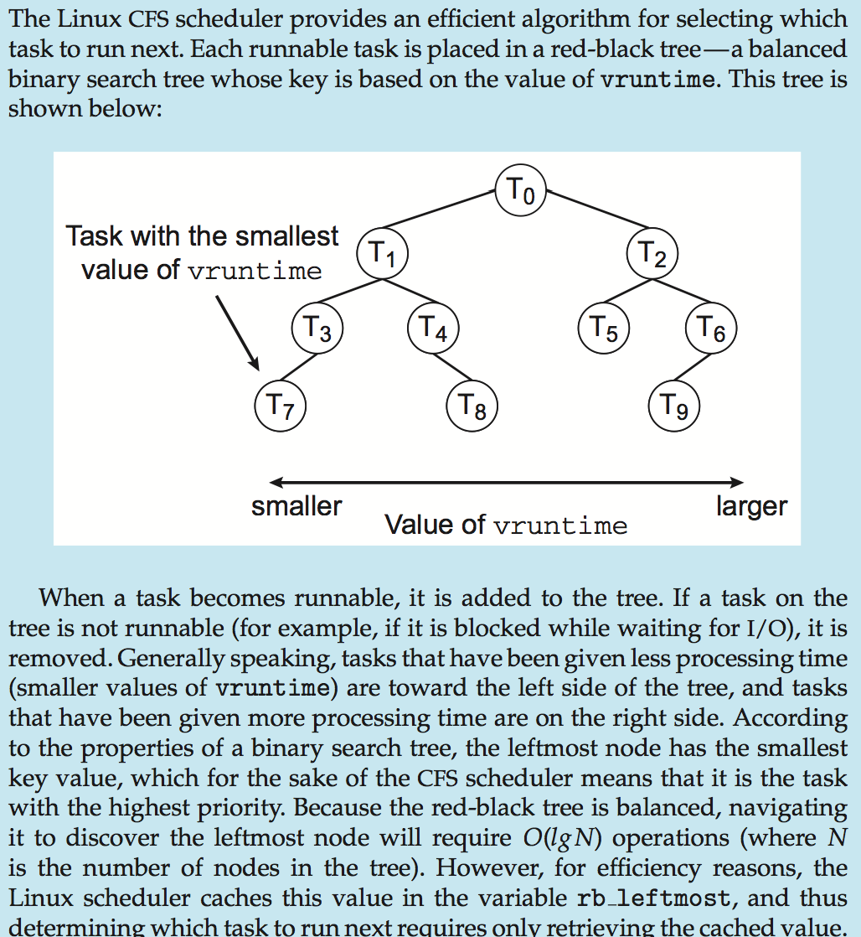
CFS Performance

Slide 56
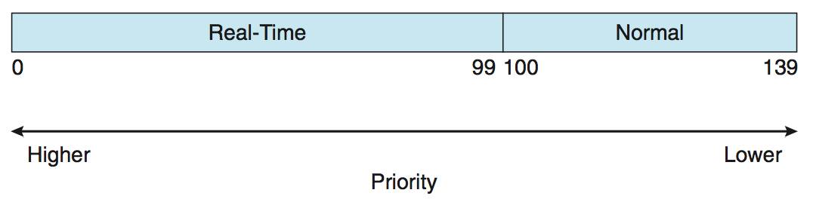
Linux Scheduling (Cont.)
Real-time scheduling according to POSIX.1b
Real-time tasks have static priorities
Real-time plus normal map into global priority scheme
Nice value of -20 maps to global priority 100
Nice value of +19 maps to priority 139

Slide 57
Windows Scheduling
Windows uses priority-based preemptive scheduling
Highest-priority thread runs next
Dispatcher is scheduler
Thread runs until (1) blocks, (2) uses time slice, (3) preempted by higher-priority thread
Real-time threads can preempt non-real-time
32-level priority scheme
Variable class is 1-15, real-time class is 16-31
Priority 0 is memory-management thread
Queue for each priority
If no run-able thread, runs idle thread

Slide 58
Windows Priority Classes
Win32 API identifies several priority classes to which a process can belong
REALTIME_PRIORITY_CLASS, HIGH_PRIORITY_CLASS, ABOVE_NORMAL_PRIORITY_CLASS,NORMAL_PRIORITY_CLASS, BELOW_NORMAL_PRIORITY_CLASS, IDLE_PRIORITY_CLASS
All are variable except REALTIME
A thread within a given priority class has a relative priority
TIME_CRITICAL, HIGHEST, ABOVE_NORMAL, NORMAL, BELOW_NORMAL, LOWEST, IDLE
Priority class and relative priority combine to give numeric priority
Base priority is NORMAL within the class
If quantum expires, priority lowered, but never below base

Slide 59
Windows Priority Classes (Cont.)
If wait occurs, priority boosted depending on what was waited for
Foreground window given 3x priority boost
Windows 7 added user-mode scheduling (UMS)
Applications create and manage threads independent of kernel
For large number of threads, much more efficient
UMS schedulers come from programming language libraries like C++ Concurrent Runtime (ConcRT) framework

Slide 60
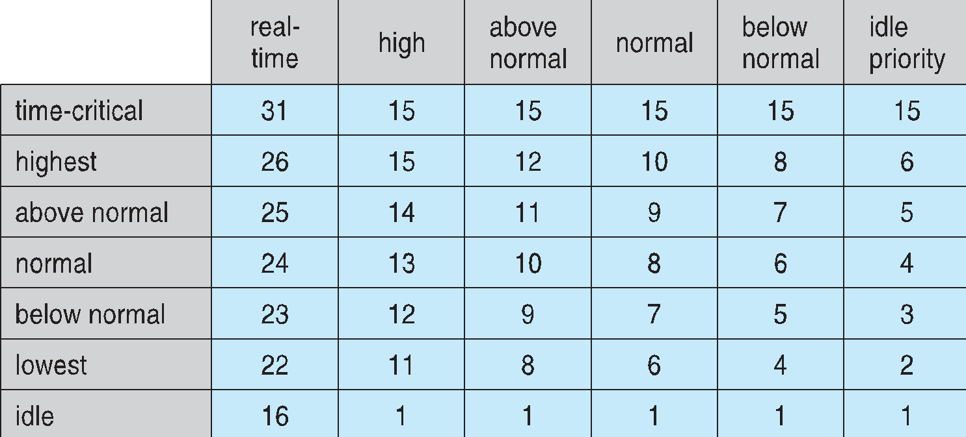
Windows Priorities

Slide 61
Solaris
Priority-based scheduling
Six classes available
Time sharing (default) (TS)
Interactive (IA)
Real time (RT)
System (SYS)
Fair Share (FSS)
Fixed priority (FP)
Given thread can be in one class at a time
Each class has its own scheduling algorithm
Time sharing is multi-level feedback queue
Loadable table configurable by sysadmin

Slide 62
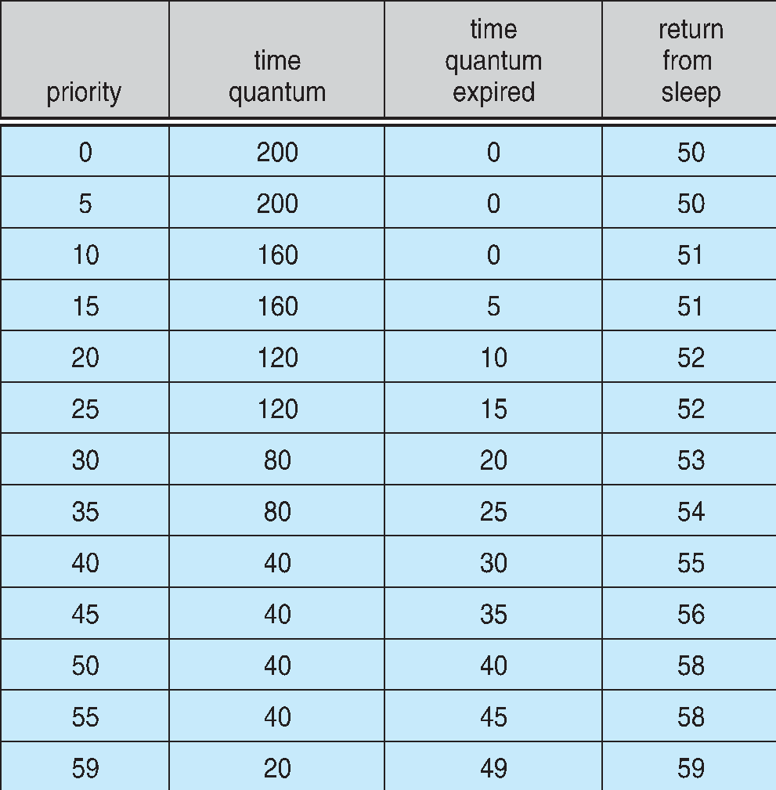
Solaris Dispatch Table

Slide 63
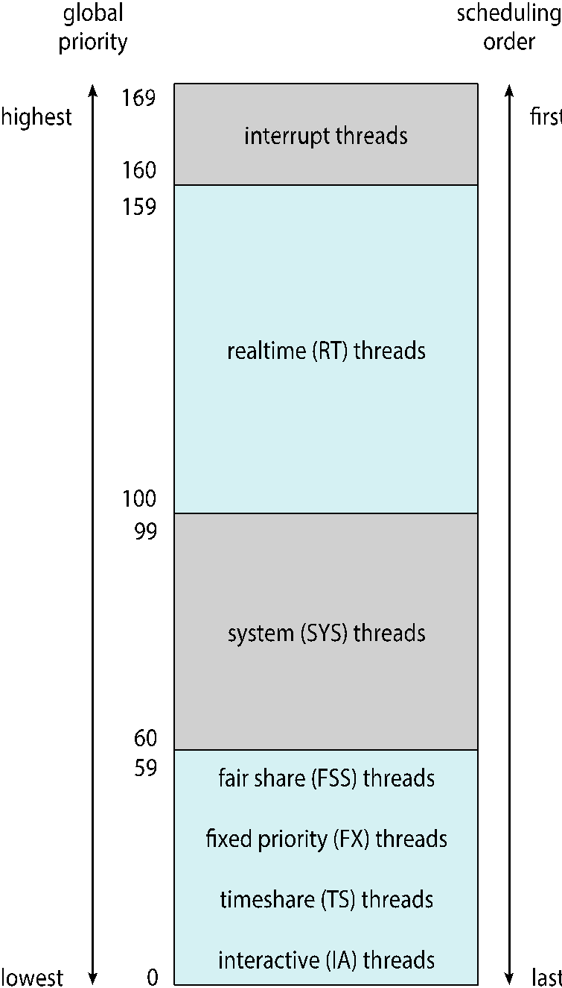
Solaris Scheduling

Slide 64
Solaris Scheduling (Cont.)
Scheduler converts class-specific priorities into a per-thread global priority
Thread with highest priority runs next
Runs until (1) blocks, (2) uses time slice, (3) preempted by higher-priority thread
Multiple threads at same priority selected via RR

Slide 65
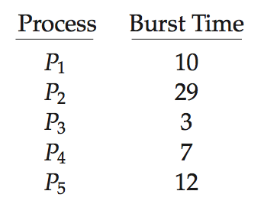
Algorithm Evaluation
How to select CPU-scheduling algorithm for an OS?
Determine criteria, then evaluate algorithms
Deterministic modeling
Type of analytic evaluation
Takes a particular predetermined workload and defines the performance of each algorithm for that workload
Consider 5 processes arriving at time 0:

Slide 66
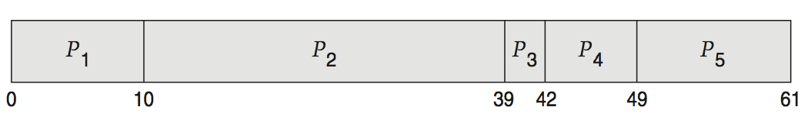
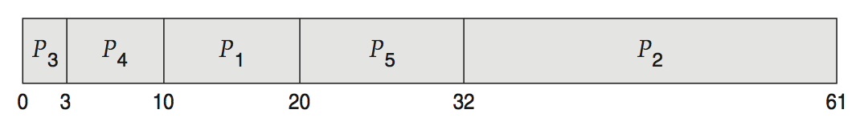
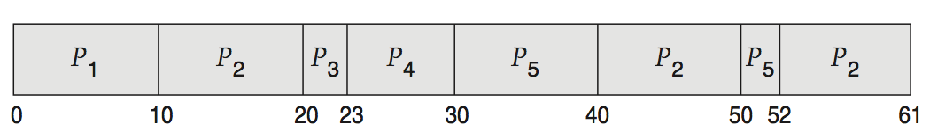
Deterministic Evaluation
For each algorithm, calculate minimum average waiting time
Simple and fast, but requires exact numbers for input, applies only to those inputs
FCS is 28ms:
Non-preemptive SFJ is 13ms:
RR is 23ms:

Slide 67
Queueing Models
Describes the arrival of processes, and CPU and I/O bursts probabilistically
Commonly exponential, and described by mean
Computes average throughput, utilization, waiting time, etc
Computer system described as network of servers, each with queue of waiting processes
Knowing arrival rates and service rates
Computes utilization, average queue length, average wait time, etc

Slide 68
Little’s Formula
n = average queue length
W = average waiting time in queue
λ = average arrival rate into queue
Little’s law – in steady state, processes leaving queue must equal processes arriving, thus: n = λ x W
Valid for any scheduling algorithm and arrival distribution
For example, if on average 7 processes arrive per second, and normally 14 processes in queue, then average wait time per process = 2 seconds

Slide 69
Simulations
Queueing models limited
Simulations more accurate
Programmed model of computer system
Clock is a variable
Gather statistics indicating algorithm performance
Data to drive simulation gathered via
Random number generator according to probabilities
Distributions defined mathematically or empirically
Trace tapes record sequences of real events in real systems

Slide 70
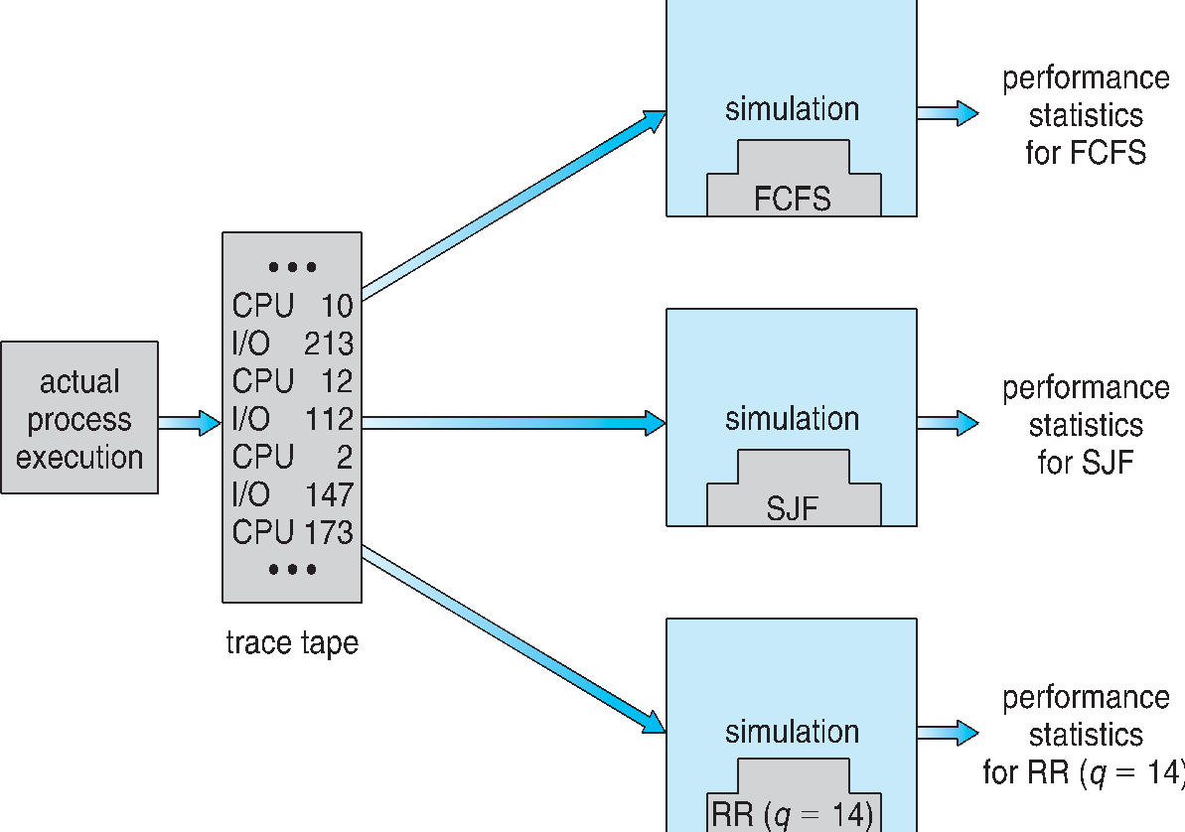
Evaluation of CPU Schedulers by Simulation

Slide 71
Implementation
Even simulations have limited accuracy
Just implement new scheduler and test in real systems
High cost, high risk
Environments vary
Most flexible schedulers can be modified per-site or per-system
Or APIs to modify priorities
But again environments vary

Slide 72
End of Chapter 6

